Slide 1
Glasswall ICAP UI Examples
Taken from Rebuild for Email and the Forensic Workbench
Rebuild For Email Dev site: https://dev.curlywurly.me/

Slide 2
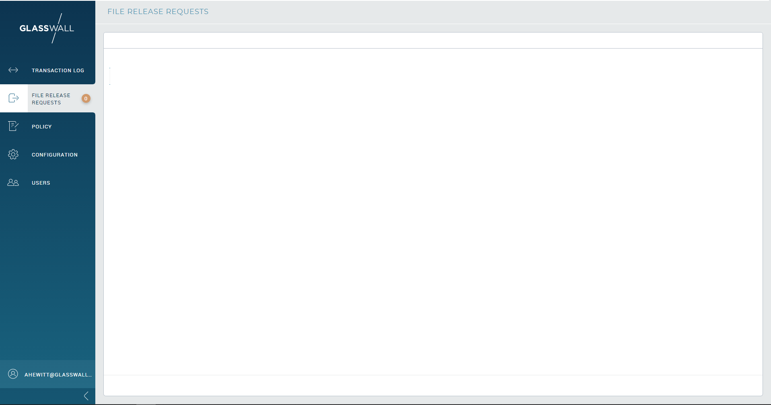
Page Layout
keep this Content Container
Similar Navbar to this, with the gradient

Slide 3
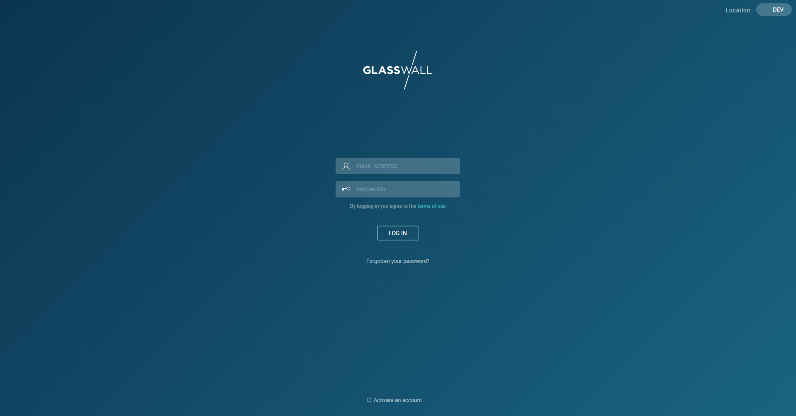
Login Page

Slide 4
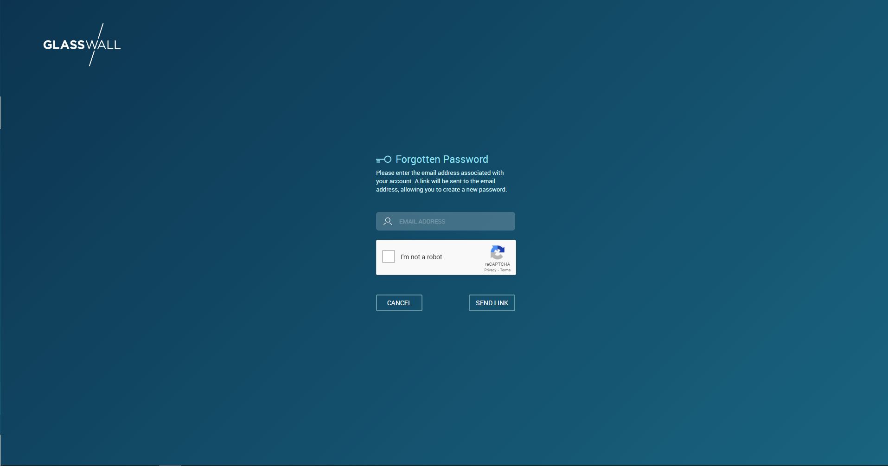
Forgotten Password Page

Slide 5
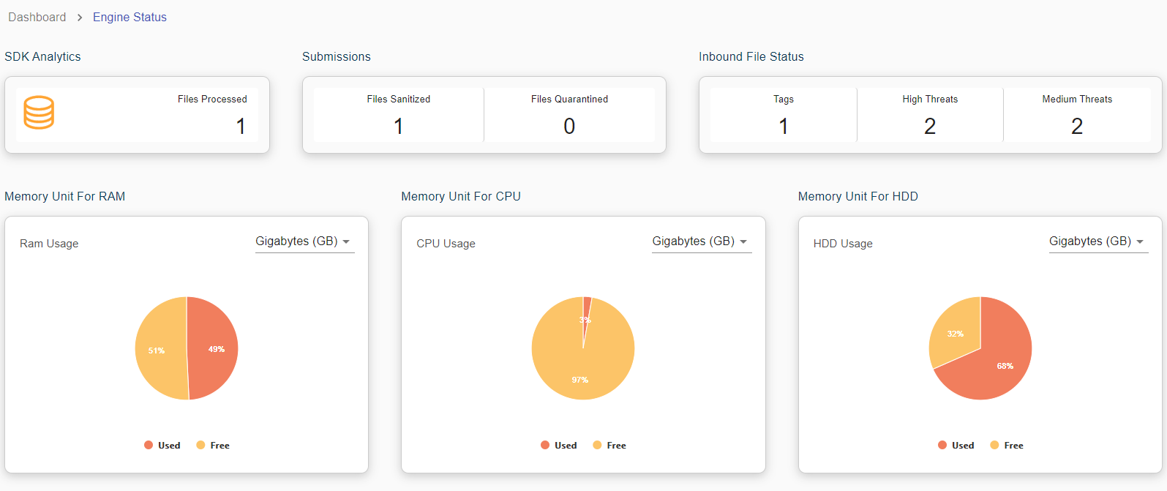
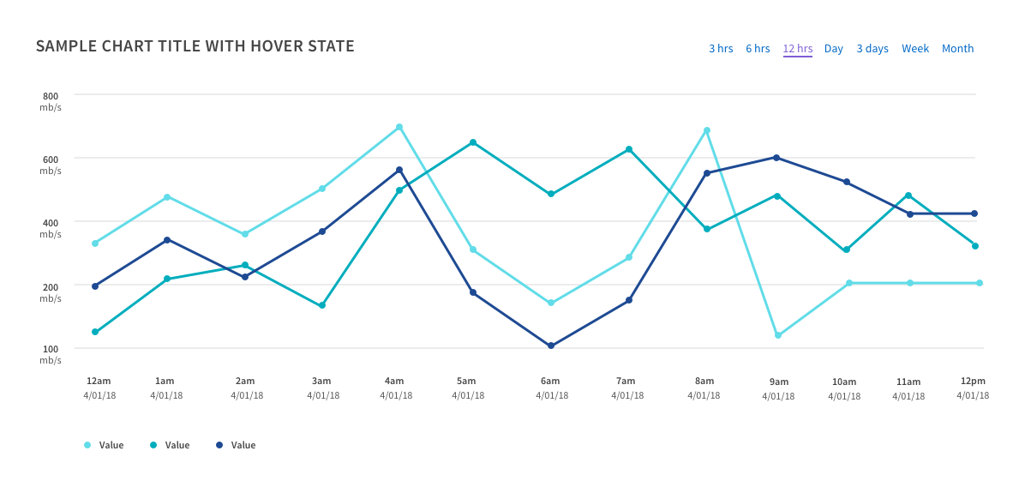
Engine Performance Dashboard View

Slide 6
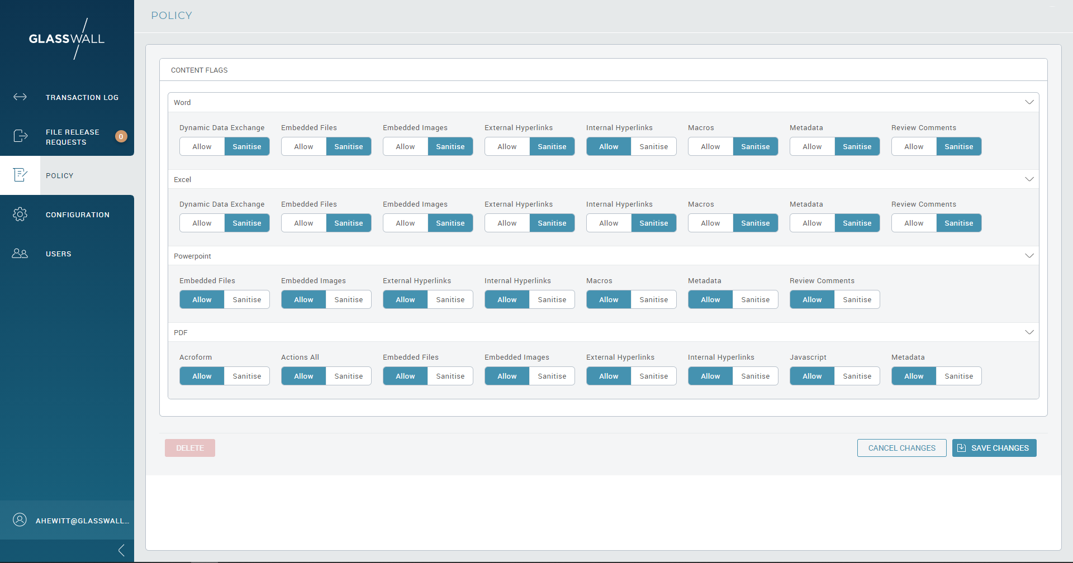
Policy Management View
Feedback when one of these is changed

Slide 7
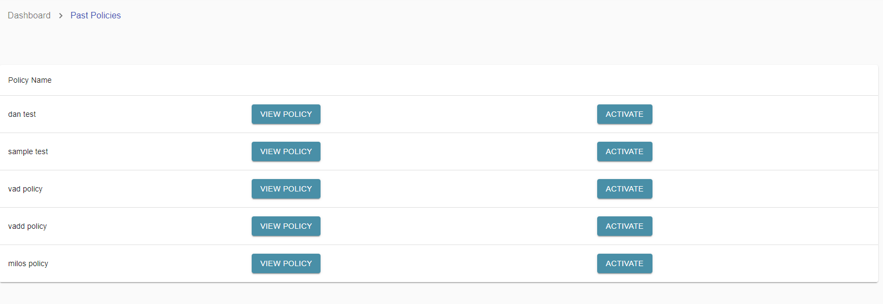
Policy History
Audit trail (history of policies and who changed them)
Timestamp
User
View Policy

Slide 8
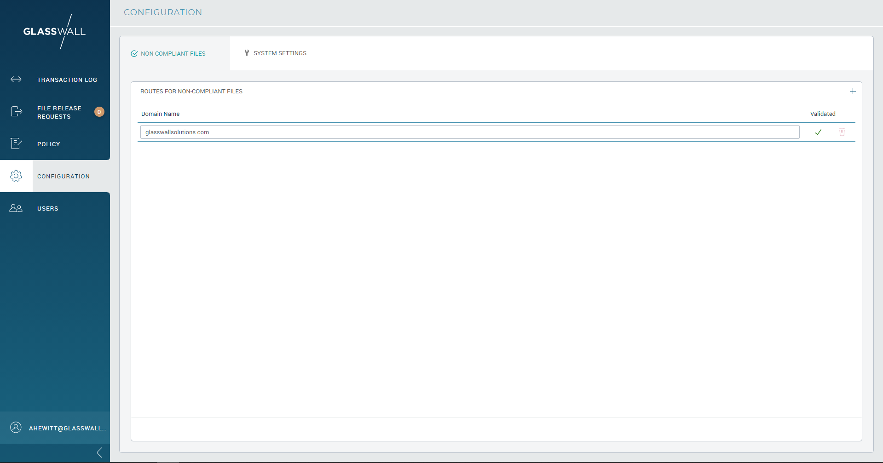
Non Compliant File Routing View

Slide 9
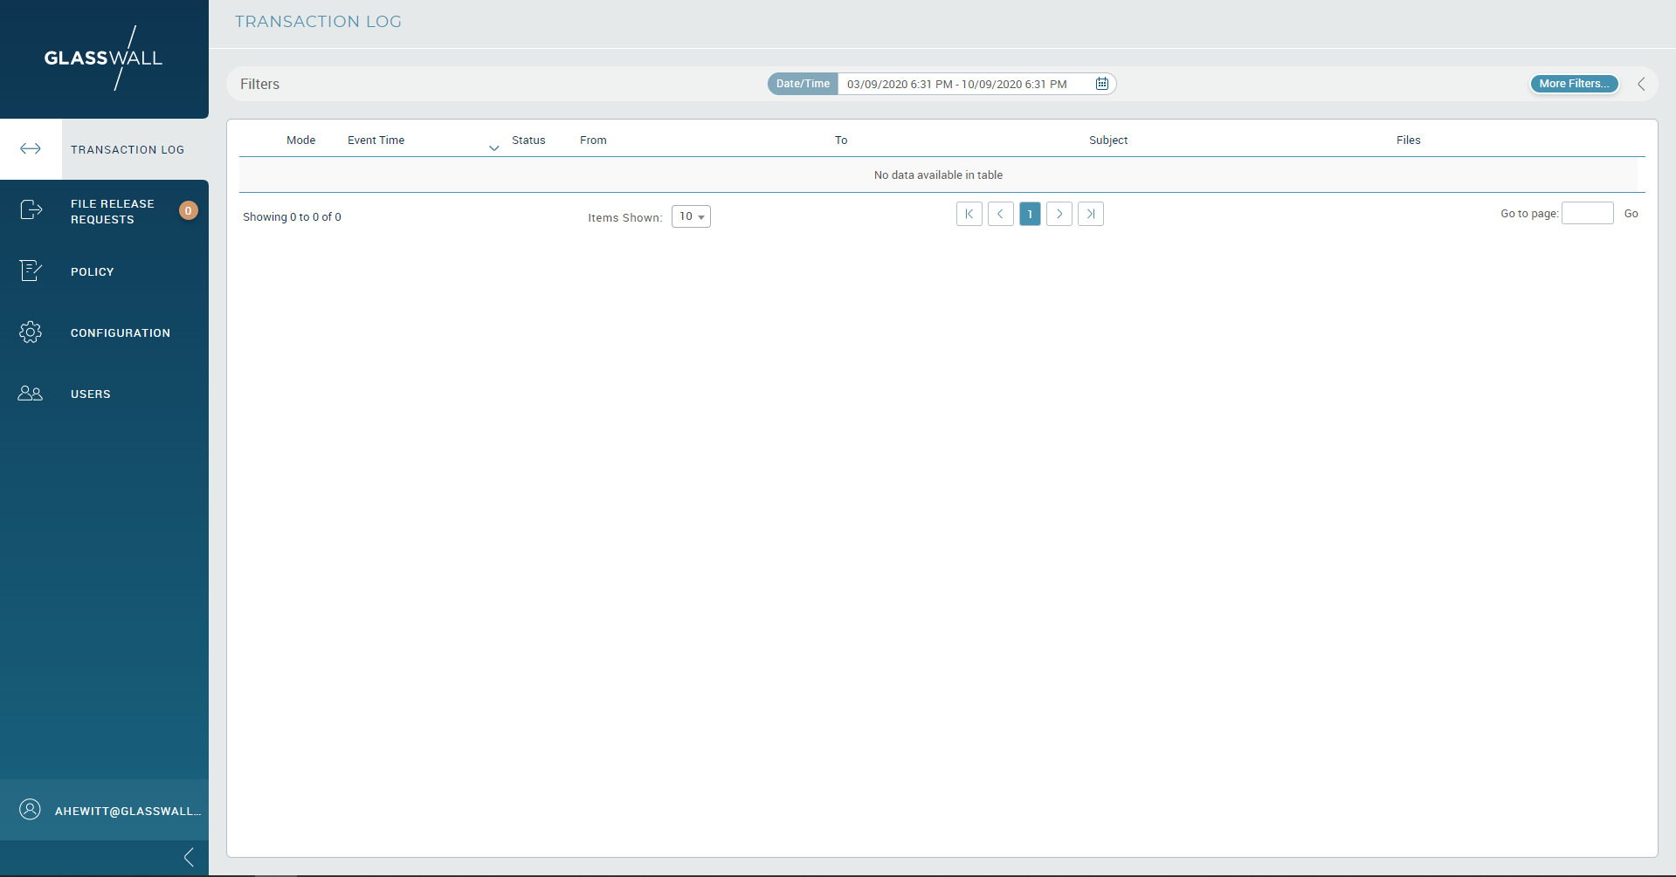
Risk and File Extension-Based View
Each row should be clickable, and request details should be shown in a menu or sidebar
Sidebar
Timestamp
URL
HOST
Outcome
Client Address
Proxy Address
hyperlink (Analysis Report)
Duration
Rebuild Duration
Request Log
Timestamp
File ID
Filename
FileType
Outcome

Slide 10
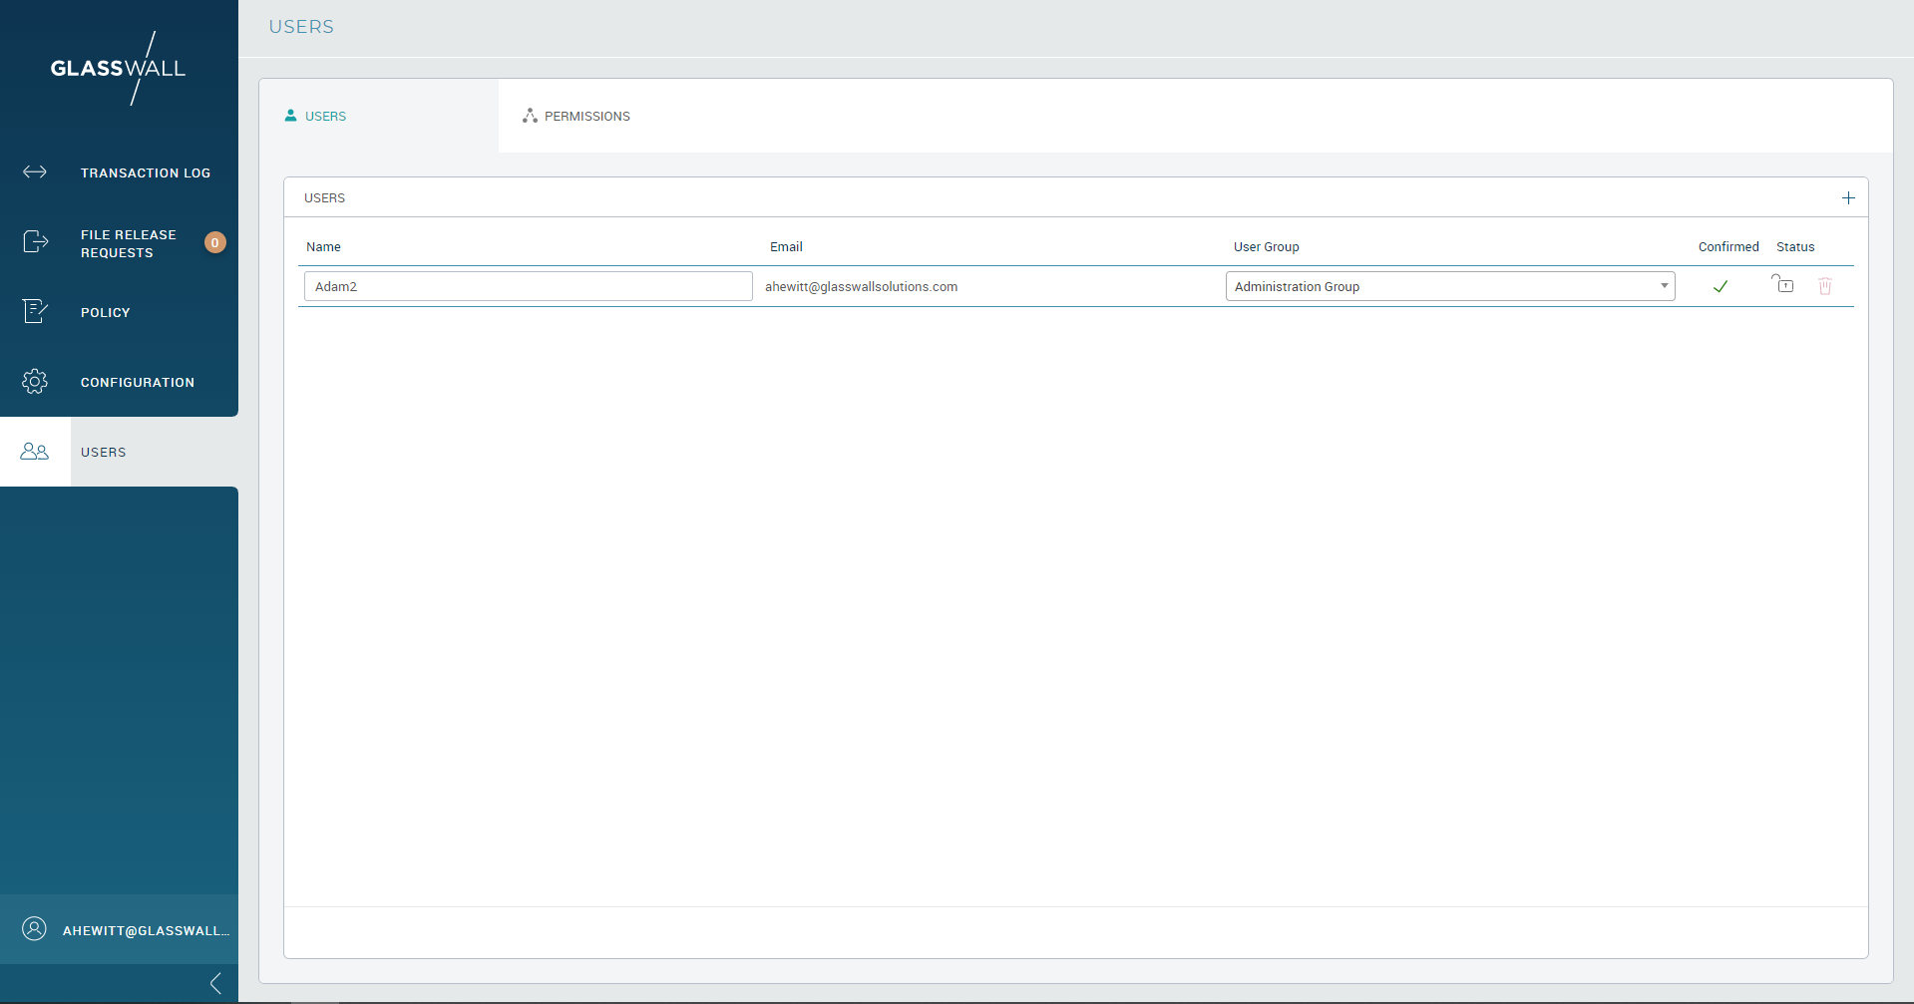
Users View

Slide 11
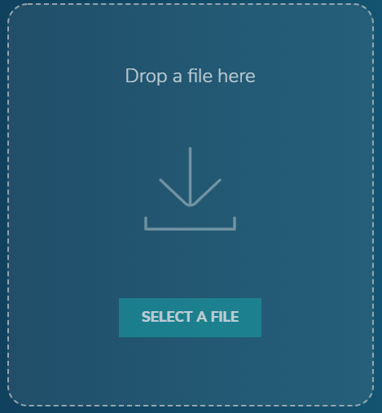
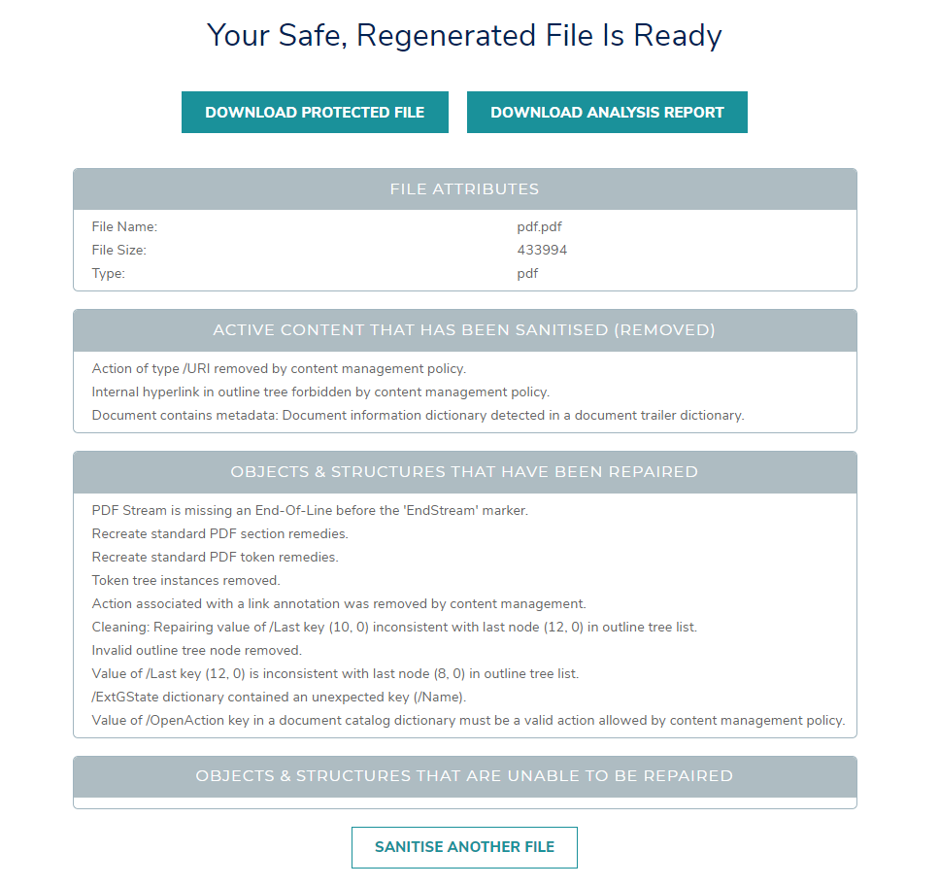
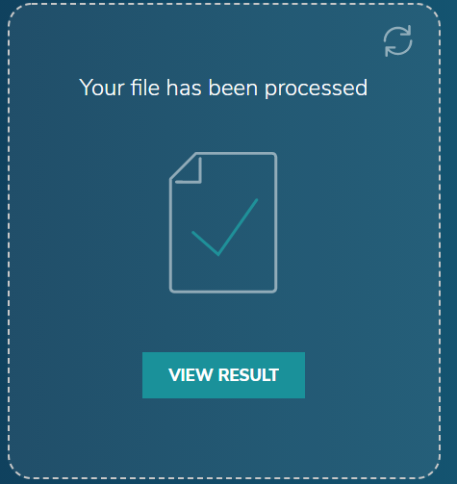
File Drop View
https://file-drop.co.uk/

